Slide 1
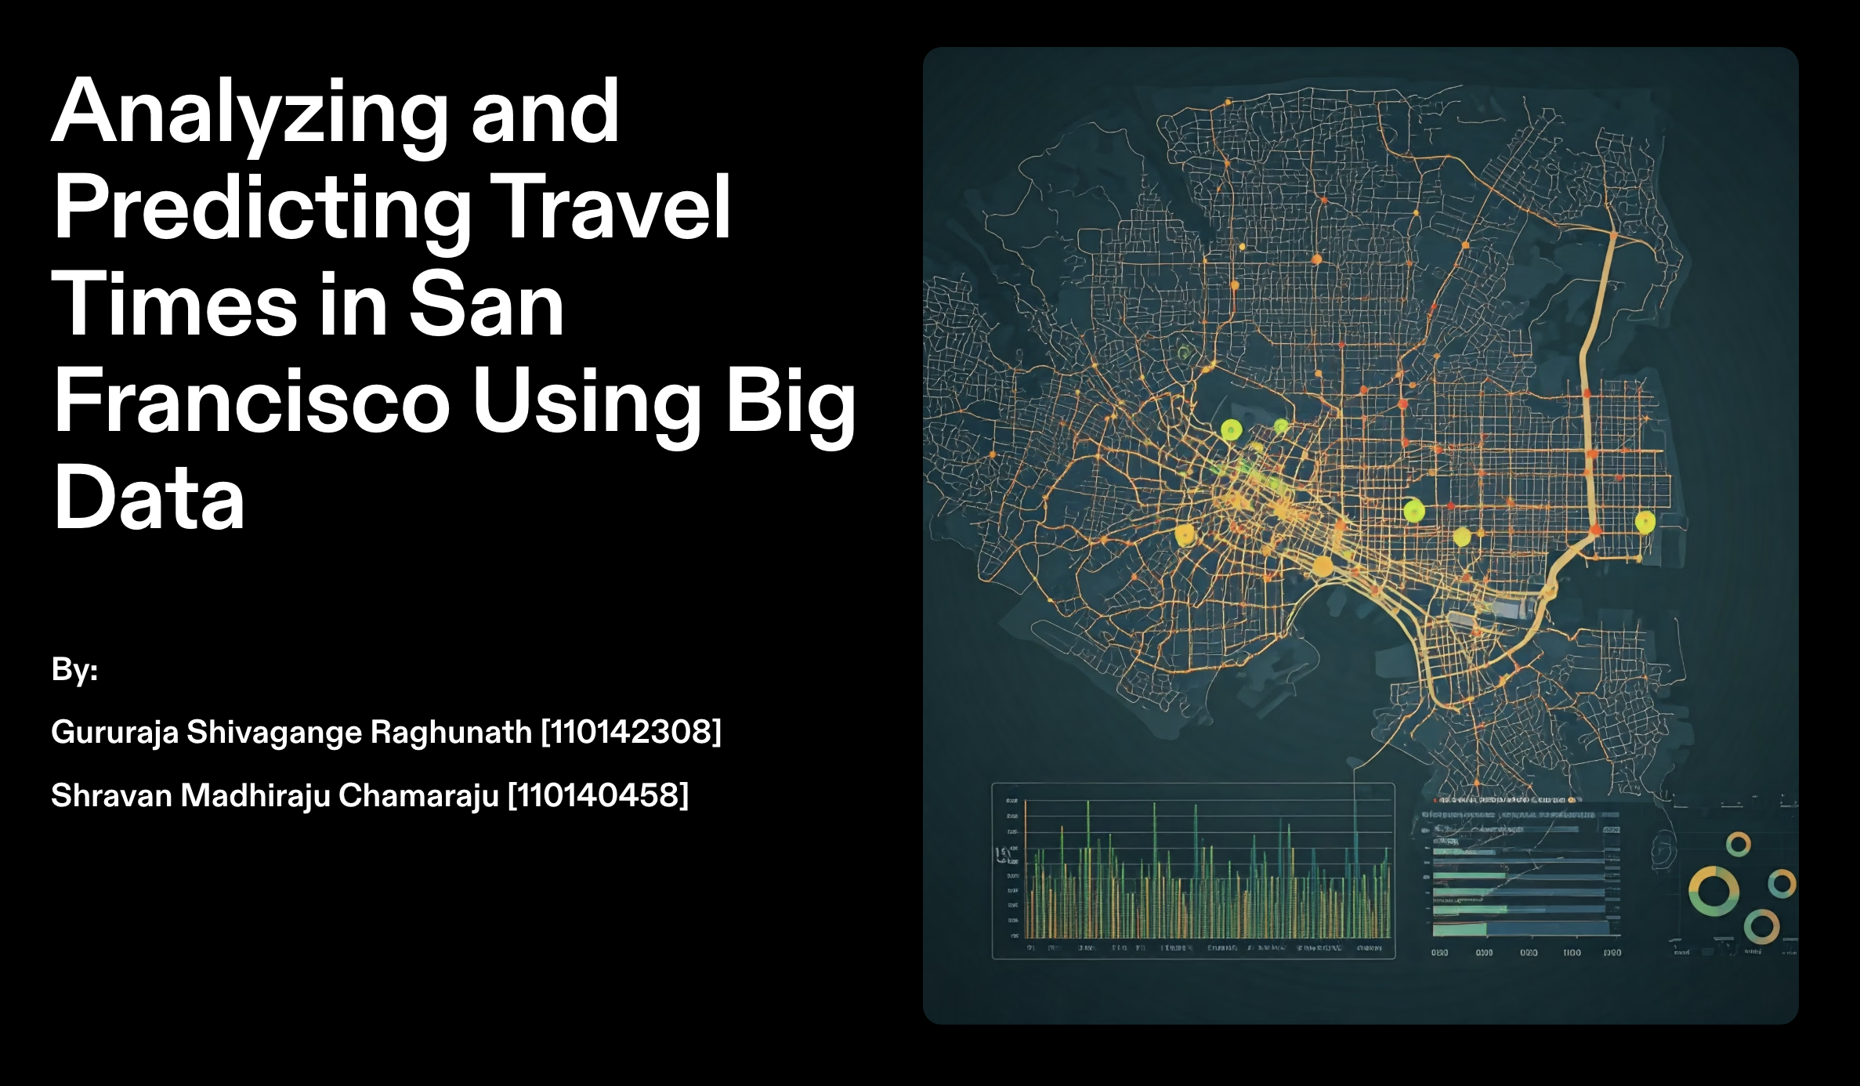

Slide 2
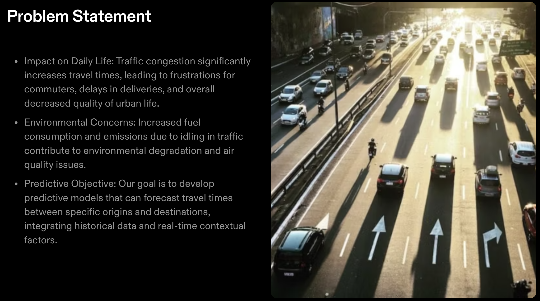

Slide 3
What is this Project About?
Predicts travel times for urban routes using machine learning.
Combines traffic, weather, and holiday data to improve prediction accuracy.
Implements ML models: Neural Networks, Linear Regression, etc.
Goal: Help commuters and city planners optimize travel plans.

Slide 4
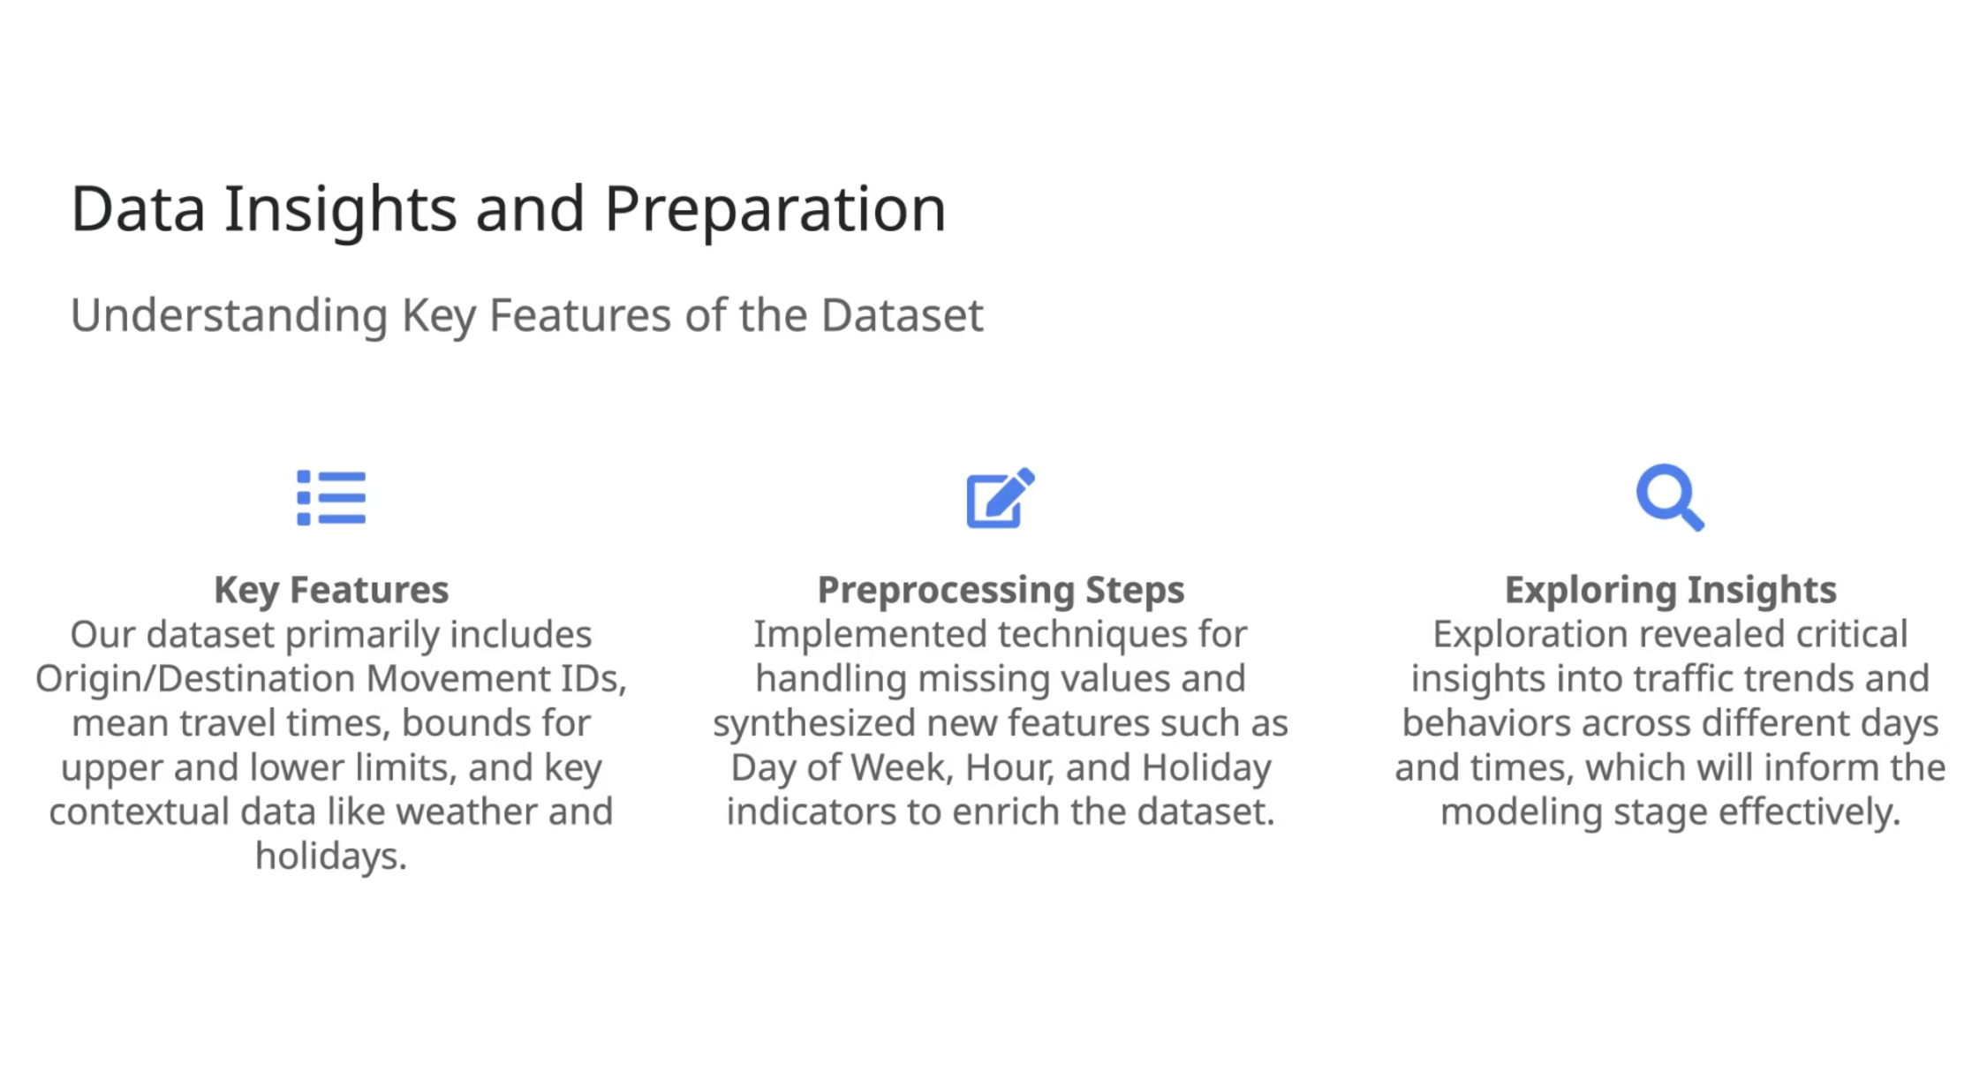

Slide 5
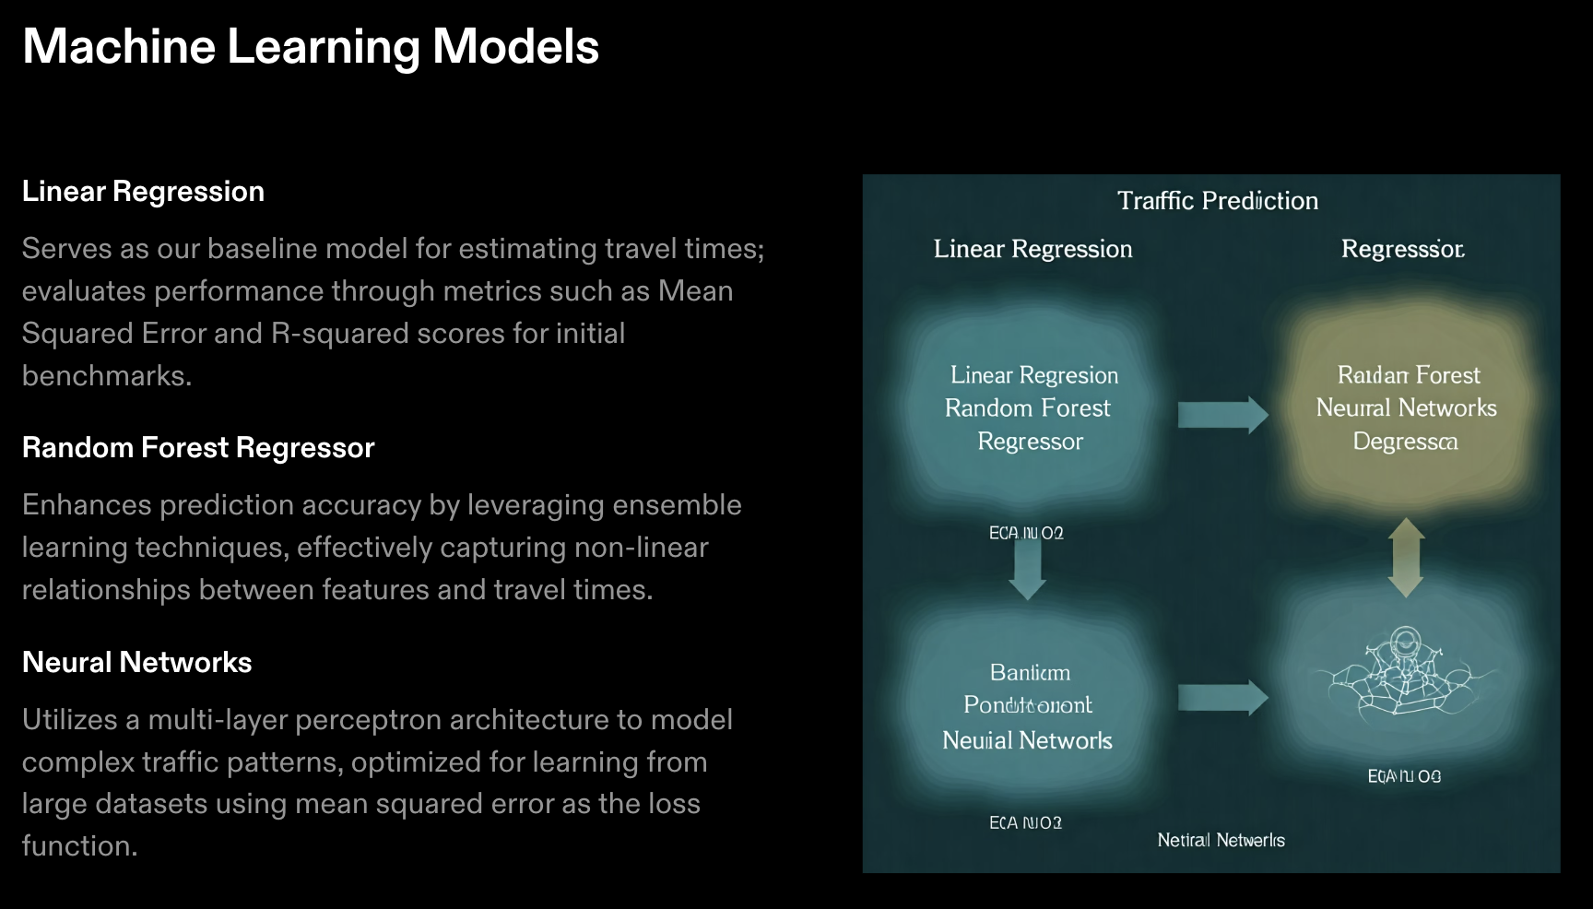

Slide 6
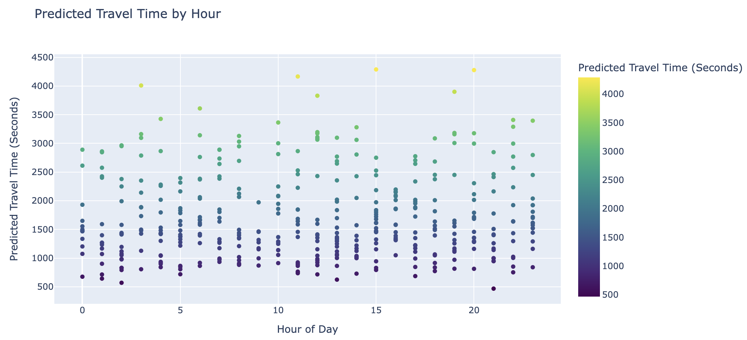
Predicted vs Actual Travel
1. Scatter Plot: Predictions vs Hours of the Day
This graph demonstrates the alignment between predicted travel times and the actual travel times across different hours of the day.
Key Insight: The Random Forest model shows a closer fit to the actual values compared to the Neural Network, especially during peak hours (e.g., morning and evening rush hours). Deviations are more noticeable in off-peak hours, likely due to data sparsity.

Slide 7
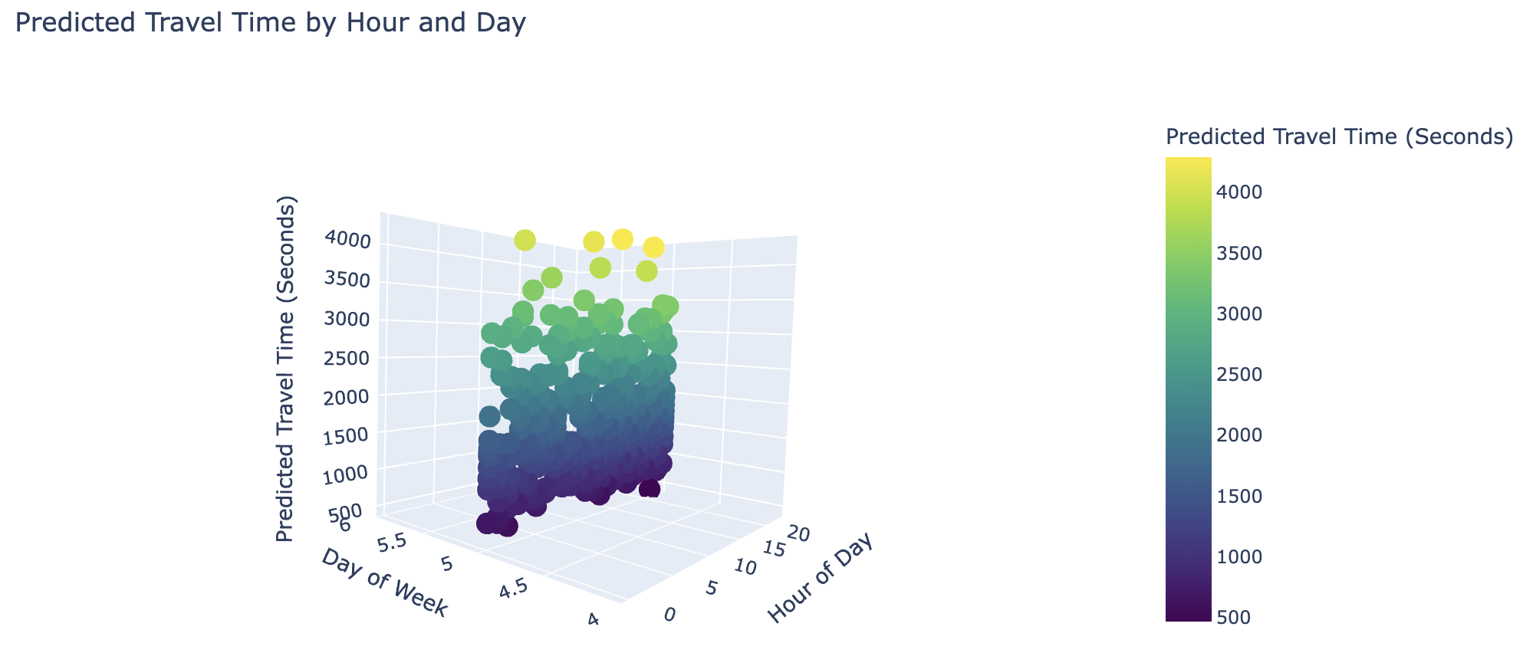
Predicted vs Actual Travel
2. 3D Plot: Travel Times by Hour and Day of the Week
The 3D visualization highlights the interaction of travel times with the time of day and day of the week.
Key Insight: Peak travel times are observed on weekdays during morning (7–9 AM) and evening (5–7 PM) hours, with reduced travel times on weekends. This plot showcases the model’s ability to predict patterns based on temporal trends and holidays.

Slide 8
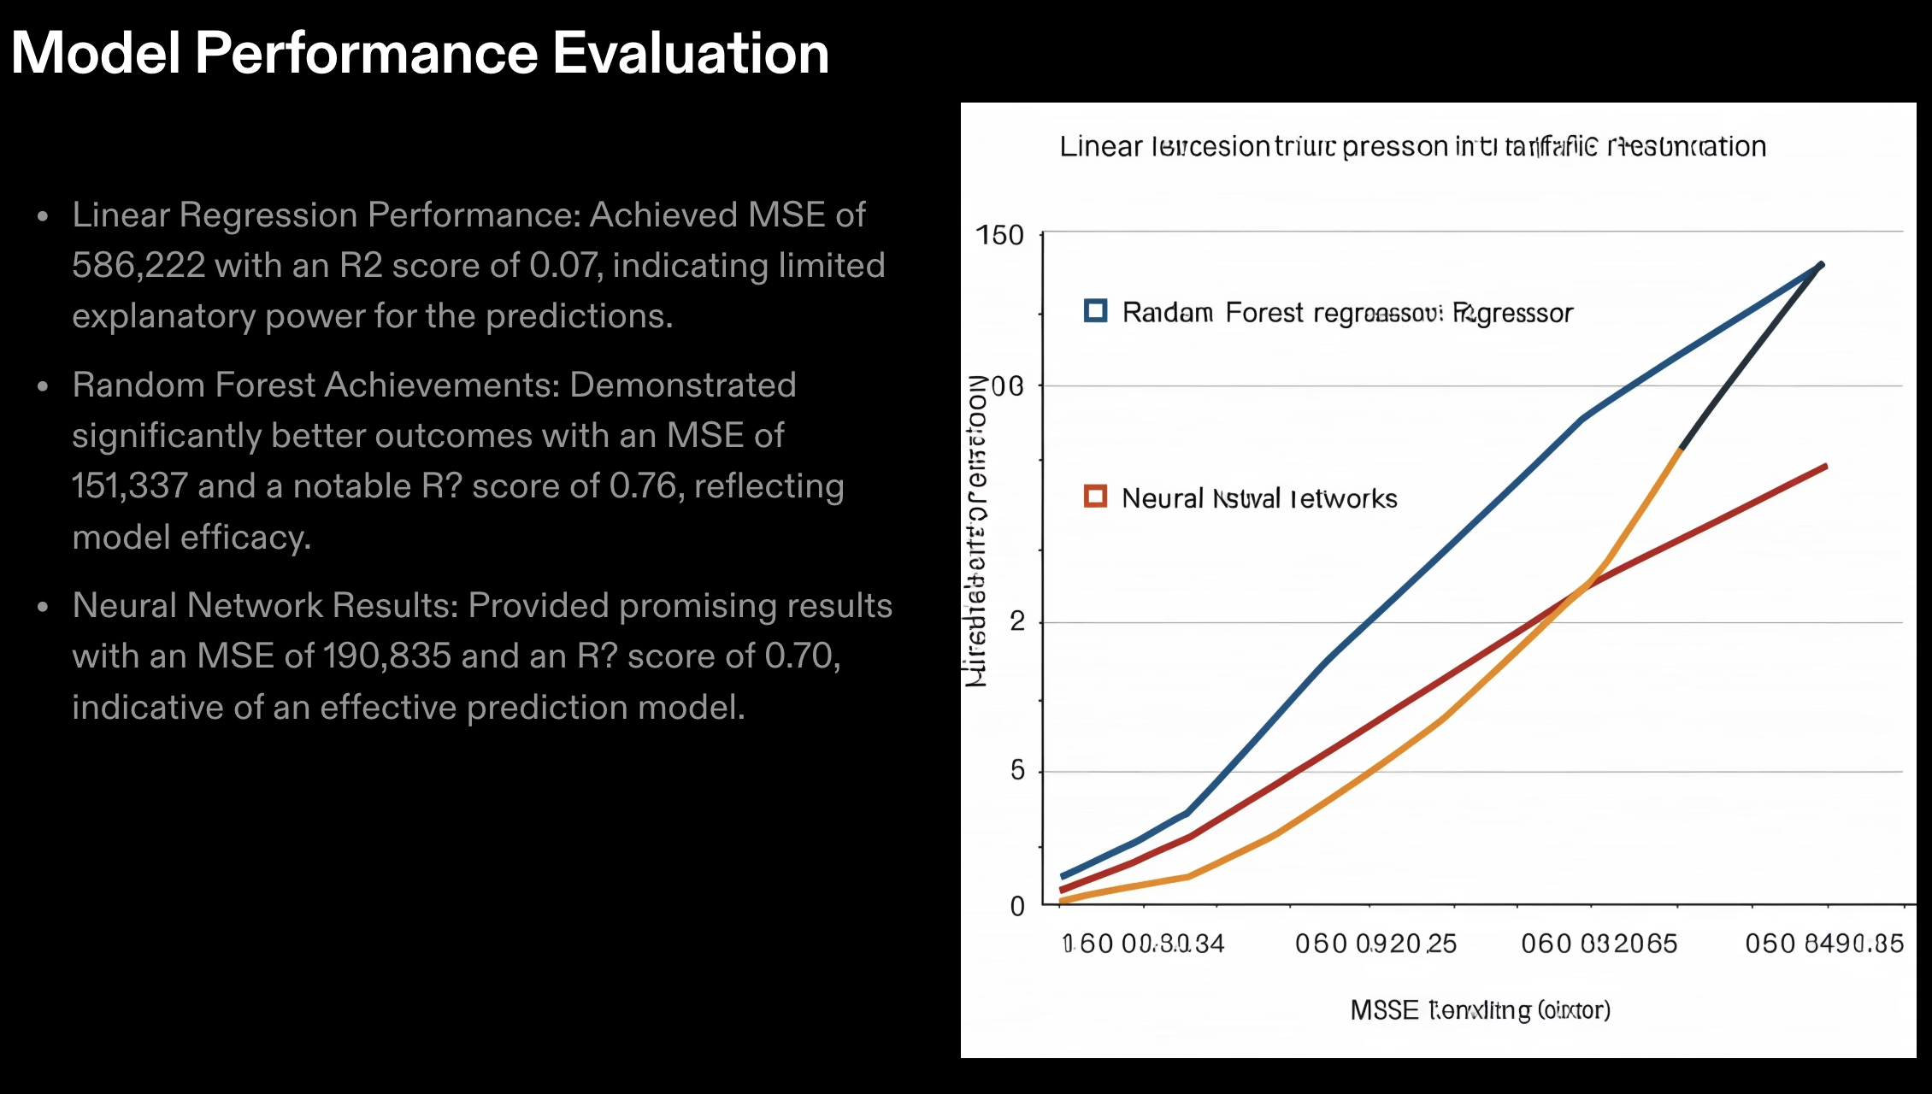

Slide 9

Conclusion and Future Work
Achievements:
The project successfully implemented machine learning models like Random Forest and Neural Networks for traffic analytics, achieving significant performance improvements through effective feature engineering and data preprocessing.
Future Directions:
Expanding the model’s capabilities by integrating real-time traffic data streams and leveraging advanced techniques like Recurrent Neural Networks (RNNs) for time-series predictions, making it scalable to other cities and diverse datasets.

Slide 10
Thank You

